Slide 1


Новая линейка сплитов HITACHI
Впервые в Украине!

Slide 2
–
R32 cерия Premium

Slide 3

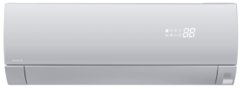


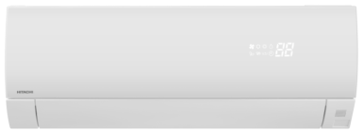









R32 серия Premium
(RAK-PSE(W/S) / RAC-WSE)
Factory: JCH-WH / Availability date: FY19Q3
Преимущества
Новые типоразмеры: 2.5, 3.5 и новые 5.0kW модели адаптированные к современным жилым помещениям
Качество воздуха: 3 эксклюзивные особенности для соответствия требованиям конечного пользователя
  Frost Wash
  Автоочистка фильтра
  Нержавеющая сталь
Экслюзивный и отмеченный наградами дизайн в 2 цветовых решениях:
  серебристый
  Белый матовый
  GOOD DESIGN Award 2018
  Высокая сезонная эффективность SEER = A+++ / SCOP = A+++
  Стабильная мощность: Заявленная теплопроизводительность гарантирована до -15°C
  Новый цифровой дисплей на передней панели
Линейка
2.5 kW | 3.5 kW | 5.0 kW
• | • | •
3 решения для чистого воздуха
R32
FROST WASH
AUTO FILTER CLEAN
STAINLESS CLEAN
EASY MAINTENANCE
CONSTANT
POWER
4 WAY SWING
SEER
SCOP
COOLING
HEATING
HIGH
EFFICIENCY

Slide 4
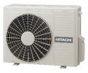

НОВОЕ
Габариты наружного блока
Новые R32 Premium (RAC-WSE)
2.5 & 3.5 kW | 5.0kW
W 792
W 800
H 600
H 736
D 299
D 350
Повышение производительности при неизменных габаритах наружных блоков

Slide 5
НОВОЕ
Новые R32 Premium (RAK-PSE(S/W))
W 795
H 294
D 250
Новый внутренний блок компактнее предыдущего Premium
Ширина <800mm ➔ легкий монтаж над дверью

Slide 6
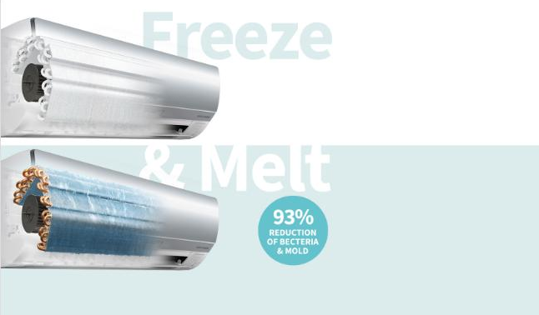
НОВАЯ ФУНКЦИЯ Frost Wash

Slide 7







НОВАЯ ФУНКЦИЯ Frost Wash
Как это работает?
Теплообменник замораживается до -15C,создается шуба из инея, которая при оттаивании смывает вместе с собой пыль с поверхности теплообменника
Operating procedure
FREEZE
MELT & WASH
DRY
20 min
1 min
60 min
Freeze the Heat Exchanger
Melt the Frost at once
to Wash away the dust
Dry the Heat Exchanger
Frost Wash ➔ Самый простой и эффективный способ очистки

Slide 8

ДИЗАЙН
Живая гармония
Белый матовый
Серебристый
Изогнутая панель создает красивый и стильный эффект
Высококачественный материал корпуса с уникальным дизайном
Форма и текстура для органичного элемента интерьера
Дизайнерское решение из высококачественных материалов в современном исполнении
➔ Оригинальный и запоминающийся дизайн

Slide 9



НОВЫЙ ДИСПЛЕЙ НА ПАНЕЛИ
Fan only
Cooling
Heating
Dehumidify
Indoor Temp.
Новая кнопка вкл/выкл подсветки
F･Wash
ECO
Filter
Clean
Frost Wash
Timer
Нажмите “Light Off/On” для включения/выключения дисплея
Новый дисплей на панели➔ современный дизайн и больше комфорта для конечного пользователя

Slide 10
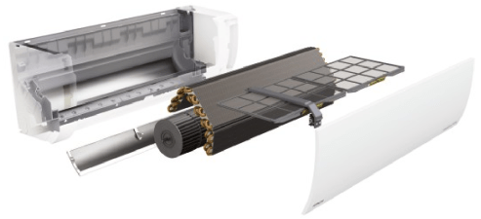
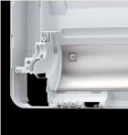
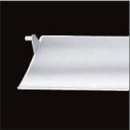

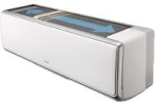
ОЧИСТКА ФИЛЬТРА
Воздушный канал из нержавеющей стали
Жалюзи из нержавеющей стали
Сетчастый нержавеющий фильтр
Очиститель
Micro Mesh
Stainless Filter
Чистый воздух выходит из кондиционера благодаря системе очистки
➔ Без пыли и других примесей

Slide 11
СТАБИЛЬНАЯ МОЩНОСТЬ
Мощность (kW)
RAK-50PSE(W/S)
5.40kW
RAK-35PSE(W/S)
3.90kW
RAK-25PSE(W/S)
3.20kW
-15
-7
+7
Наружная температура(℃)
Заявленная тепловая мощность поддерживается до -15°C

Slide 12


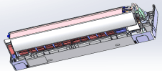
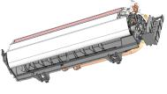
ПРОСТОТА МОНТАЖА
Новое шасси
  Цельная передняя панель
    Нет разницы в цвете между корпусом и передней панелью➔ более эстетичный внешний вид
  Легкий доступ к трубам под агрегатом ➔ экономия времени на установку
Новое шасси разработано с учетом запросов инсталляторов и конечных пользователей

Slide 13
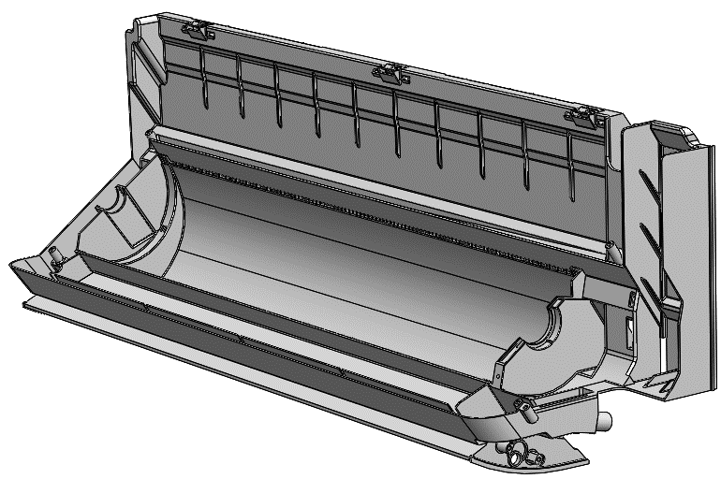


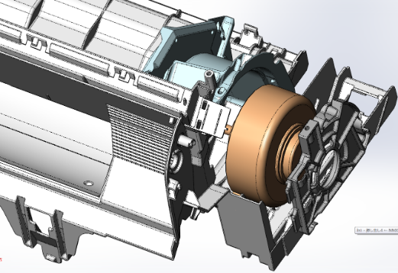
ЛЕГКОЕ ОБСЛУЖИВАНИЕ
Новое шасси
  Комбинирование корпуса и поддона в одно целое
    Улучшенная циркуляция воздуха➔ больше возможностей
  Легкое обслуживание➔ экономия времени для инсталлятора
корпус
Дренажный поддон
Двигатель вентилятора можно легко снять не снимая теплообменник

Slide 14
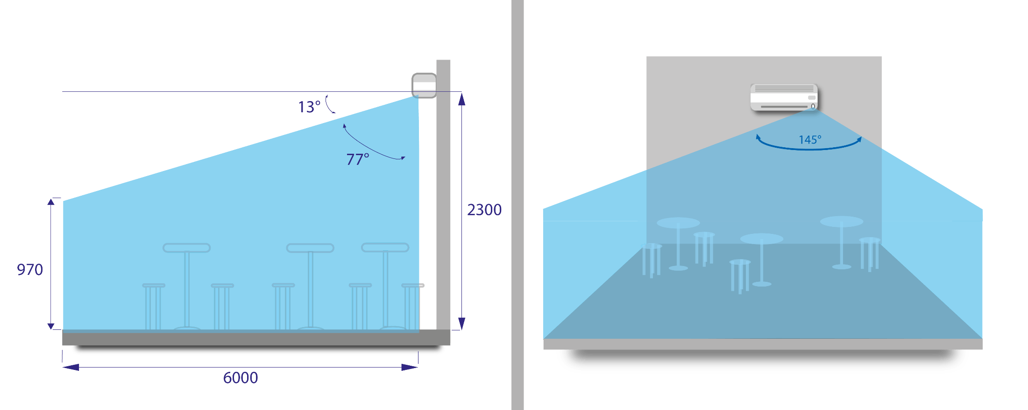
ДАТЧИК ПРИСУТСТВИЯ
Широкий угол обнаружения

Slide 15
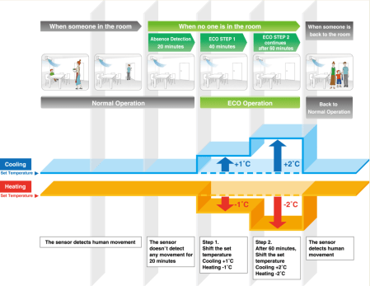
ДАТЧИК ПРИСУТСТВИЯ
  Логика управления идентична другим блокам RAC с датчиком присутствия
Когда никого нет в помещении, режим энергосбережения запускается в 2 этапа➔ +/-1°= 7% экономия энергии

Slide 16
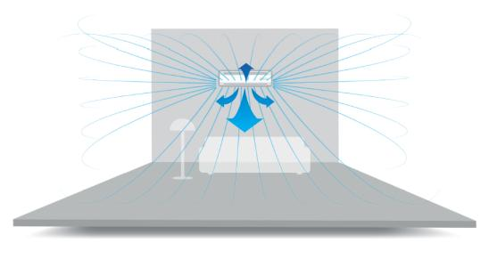
4х сторонняя подача
Горизонтальная & Вертикальная Авто-регулировка ➔ 4х сторонняя подача
  Температура в помещении равномерно распределяется за счет создания вертикального и горизонтального воздушных потоков
4 WAY SWING
Больше комфорта для пользователя

Slide 17

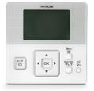
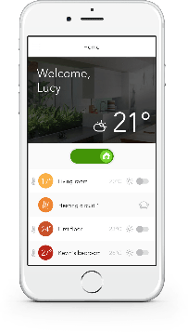

ВАРИАНТЫ УПРАВЛЕНИЯ
+
NEW
RAR-6NE2
Беспроводной пульт
SPX-WKT3
Проводной пульт
Основные особенности:
Еженедельное расписание
Учет энергии/ комнатная темп. /
Коды аварий
Новая функция FrostWash
Основные особенности:
Еженедельное расписание
Учет энергии/ комнатная темп. /
Коды аварий
Возможность центрального управления
Блокировка
Эко-Авто отключение
SPX-WFG01
WiFi
SPX-RCDB
Простой проводной пульт
Основные особенности :
Еженедельное расписание
Комнатная темп. / коды аварий
Возможность центрального управления
Основные особенности :
Простой таймер
Возможность центрального управления
Широкий ассортимент устройств управления для соответствия любым запросам

Slide 18

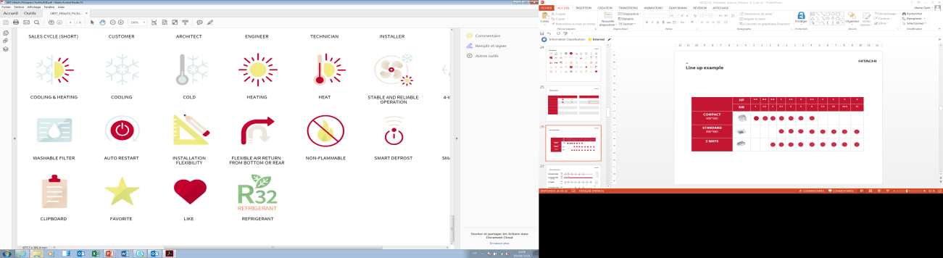
ИТОГО
Расширенный ассортимент: 2.5, 3.5 и новый 5.0kW блоки адаптированные для требований современных помещений
Качество воздуха: 3 эксклюзивные функции для соответствия запросам покупателей:
  Frost Wash
  Авто очистка фильтра
  Фильтр из нержавеющей стали
Эксклюзивный дизайн с 2 новыми цветами корпуса :
  Серебристый
  Белый матовый
  Высокая энергоэффективность SEER = A+++ / SCOP = A+++
  Теплопроизводительность не снижается до -15°C (Constant Power)
  Экологичный хладагент: R32
  Компактные габариты(width = 798 mm)
  Премия Good Design
  Датчик присутствия и 4х сторонняя подача воздуха
  Полный спектр устройств управления(включая управление по Wi-Fi)
  Простой монтаж: цельные шасси
  Простое обслуживание: новые шасси+ HiKumo Pro эксклюзивное решение
FROST WASH
SCOP
SEER
Новая серия Premium идеально соответствует требованиям рынка

Slide 19
–
New R32
Wall Hi-End
RAC Product Development

Slide 20

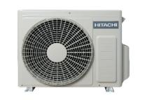

R32 Wall Hi-End
(RAK-(Q/R)XE / RAC-WXE)
Factory: JCH-WH / Availability date: FY19Q2
Line-up
2.5 kW | 3.5 kW
• | •
*Multi only
Features
New range: Complete and consistent range from 2,5 to 5,0kW
Energy savings:
  High seasonal performances SEER = A+++ / SCOP = A+++
  Human sensor
  Air quality
  Exclusive Frost Wash feature to match end-user requirements
  High comfort level:
  Constant Power
  Working range to down to -20°C
Differentiated design matching perfectly with Hi-End Floor
Easy selection: Single & Multi compatibility
4 Way Swing: homogeneous temperature in the room
R32
FROST WASH
CONSTANT
POWER
4 WAY SWING
SEER
SCOP
COOLING
HEATING
HIGH
EFFICIENCY

Slide 21
Line-up
Compatibility
RAC-WXD
RAK-RXD
RAM-NPB
RAM-NYPB
RAK-QXD
RAK-QXE
RAM-NPE
RAC-WXE
RAK-RXE
R410A
R32
New « E » generation IDU are compatible
only with « E » generation single & multi ODU

Slide 22
IMPROVEMENTS
R32 Hi-End vs R410A Hi-End: SEER
A+++
A+++
A+++
A+++
A++
A++
SEER have been improved for all the range

Slide 23
IMPROVEMENTS
R32 Hi-End vs R410A Hi-End: SCOP
A+++
A+++
A++
A++
A++
A+
SCOP have been improved for all the range.
➔ 1 energy class more for 2.5 and 3.5 kW

Slide 24
IMPROVEMENTS
R32 Hi-End vs R410A Hi-End: Heating Capacity @-7°C
+14%
+18%
Heating capacity at low temperatures has been drastically improved
compared to previous model.

Slide 25


IMPROVEMENTS
R32 Hi-End vs R410A Hi-End: COP/EER
  COP
Eco
3.705
Italy tax incentive
COP and EER have been improved
for all the range
  EER
3.23
Italy tax incentive

Slide 26
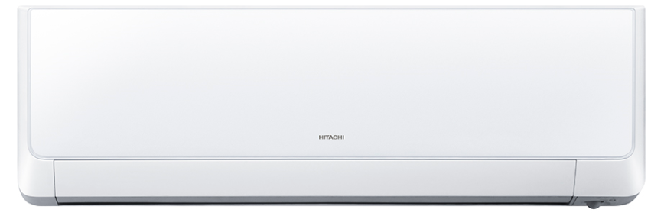
IMPROVEMENTS
R32 Hi-End vs R410A Hi-End: Indoor units dimensions
CURRENT R410A HI-END (RAK-RXB)
2,5 kW | 3,5 kW
H 295
W 900
D 210
NEW R32 HI-END (RAK-RXE)
2,5 kW | 3,5 kW
H 295
D 210
W 900
Same indoor unit for all the range

Slide 27
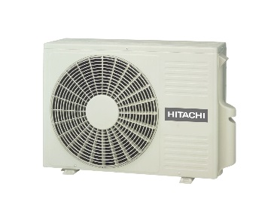
IMPROVEMENTS
R32 Hi-End vs R410A Hi-End: Outdoor units dimensions
CURRENT R410A HI-END (RAC-WXB)
2,5 kW | 3,5 kW
W 750
H 548
D 288
NEW R32 HI-END (RAC-WXE)
2,5 kW | 3,5 kW | 5,0 kW
W 792
H 600
D 299
Slight increase of outdoor units dimensions ➔ better performances
Same 5.0 kW outdoor unit

Slide 28
IMPROVEMENTS
R32 Hi-End vs R32 Standard: SEER
A+++
A+++
A+++
A++
SEER have been improved in order to keep range consistency:
1 energy class more for 3.5 kW units

Slide 29
IMPROVEMENTS
R32 Hi-End vs R32 Standard: SCOP
A+++
A++
A+++
A++
A++
A++
SCOP have been improved in order to keep range consistency:
1 energy class difference for 2.5 and 3.5 kW units

Slide 30
IMPROVEMENTS
R32 Hi-End vs R32 Standard: HEATING CAP @-7°C
+34%
+17%
+6%
Hi-End is positioned as a real heating model within Hitachi range
➔ differenciation vs Standard

Slide 31

NEW FROST WASH FUNCTION
Frost Wash function is available only on Wall Indoor Unit with Human sensor.
Auto Mode
Manual Mode
Auto Start Conditions
Frost Wash function will be automatically launched after 42 operating hours
Frost Wash function will be launched, only if nobody is in the room in order to ensure end-user comfort (FW will start operating after 15 minutes absence).
How to start Frost Wash?
Manual FW can be launched only when the unit is OFF.
FW is activated by pushing the button
Frost Wash function start only when nobody is in the room
➔ Maximum end user comfort

Slide 32
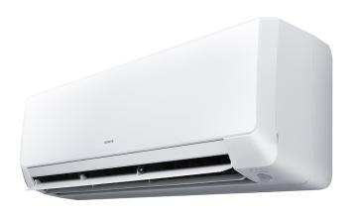
DESIGN
High Quality Finish
Mastered design and finish
Front Panel
Frosted Glassy Finish
Cabinet & Front Cover
Matte Finish
U-Shaped Frame
Luster Finish

Slide 33
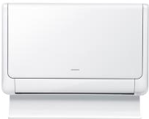
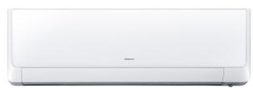
DESIGN
Family effect
RAK-RXE and RAF-RXE
Cabinet & Front Cover
Matte Finish
&
U-Shaped Frame
Luster Finish

Slide 34
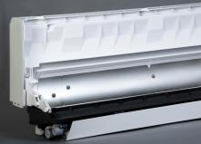
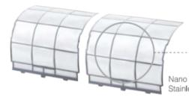

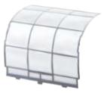
STAINLESS STEEL
Stainless steel
  Stainless Air Duct
    Stainless is used for the air duct located in the
    back of the fan.
    It has disinfection and antifouling effects, and
    keeps the interior of the air conditioner clean
  Stainless Pre-Filter
    Contamination-resistant stainless filter.
    Even greasy contaminants can be removed
    with a quick wipe.
Air quality is ensured thanks to stainless components

Slide 35
CONSTANT POWER
Capacity (kW)
RAK-35RXE
4.00kW
RAK-25RXE
3.20kW
-15
-7
+7
Outdoor temperature (℃)
Heating Capacity is kept down to -15°C

Slide 36
Controls Range
Weekly wireless remocon
SPX-WKT3
Weekly wired remocon
Main features:
Weekly timer
Energy consumption / Room temp. /
Alarm codes
Main features:
Weekly timer
Energy consumption / Room temp.
/ Alarm codes
Centralized control possible
Lock
Eco-Auto Off
SPX-WFG01
Wi-Fi
SPX-RCDA/B
Simple wired remocon
Main features:
Weekly timer
Room temp. / Alarm codes
Centralized control possible
Main features:
Simple timer
Centralized control possible
Complete range in order to match with all the applications

Slide 37

SUMMARY
Exclusive features ➔ Frost Wash function
High seasonal performances: A+++ / A+++
Constant Power
Heating working range up to -20°
Sustainable refrigerant R32
Human sensor
Complete controls range (including Wifi control)
Easy maintenance: HiKumo Pro exclusive solution
4 way swing: homogeneous temperature in the room
Differentiated IDU design & family effect with floor
4 WAY SWING
SCOP
SEER
Performance, design and exclusive function to ensure optimum comfort

Slide 38
–
New R32
Wall Standard
RAC Product Development

Slide 39


R32 Wall Standard
(RAK-(Q/R)PE / RAC-WPE)
Factory: JCH-WH / Availability date: FY19Q2
2.5 kW | 3.5 kW | 5.0 kW
• | • | •
Line-up
*Multi only
Features
New range: Complete and consistent range from 2,0 to 5,0kW
Energy savings: High seasonal performances SEER = A+++ / SCOP = A++
  Air quality: Exclusive Frost Wash feature to match end-user requirements
  High comfort level:
  High heating capacity @ low temperatures
  4 way swing
Performance and discretion: One of the most compact unit on the market (780mm)
Easy selection and installation:
Single & Multi compatibility
Easy access to piping connection
Easy maintenance:
Chassis: easy access to fan motor
Exclusive HiKumo Pro compatibility
R32
FROST WASH
COMPACT
EASY
MAINTENANCE
4 WAY SWING
SEER
SCOP
COOLING
HEATING
HIGH
EFFICIENCY

Slide 40
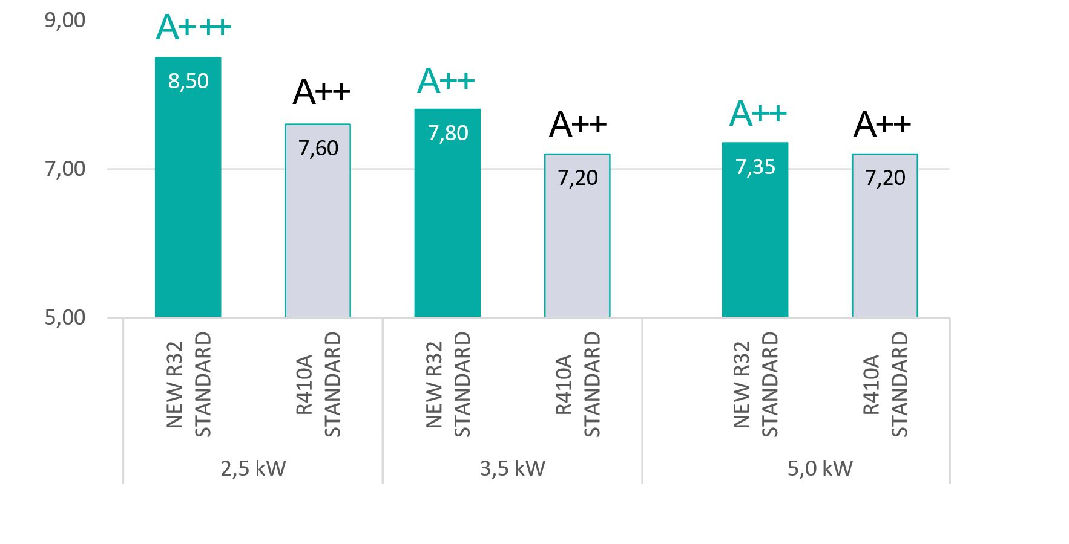
IMPROVEMENTS
R32 Standard vs R410A Standard: SEER
SEER have been improved for all the range
➔ one energy class more on 2.0 kW and 2.5 kW units.

Slide 41
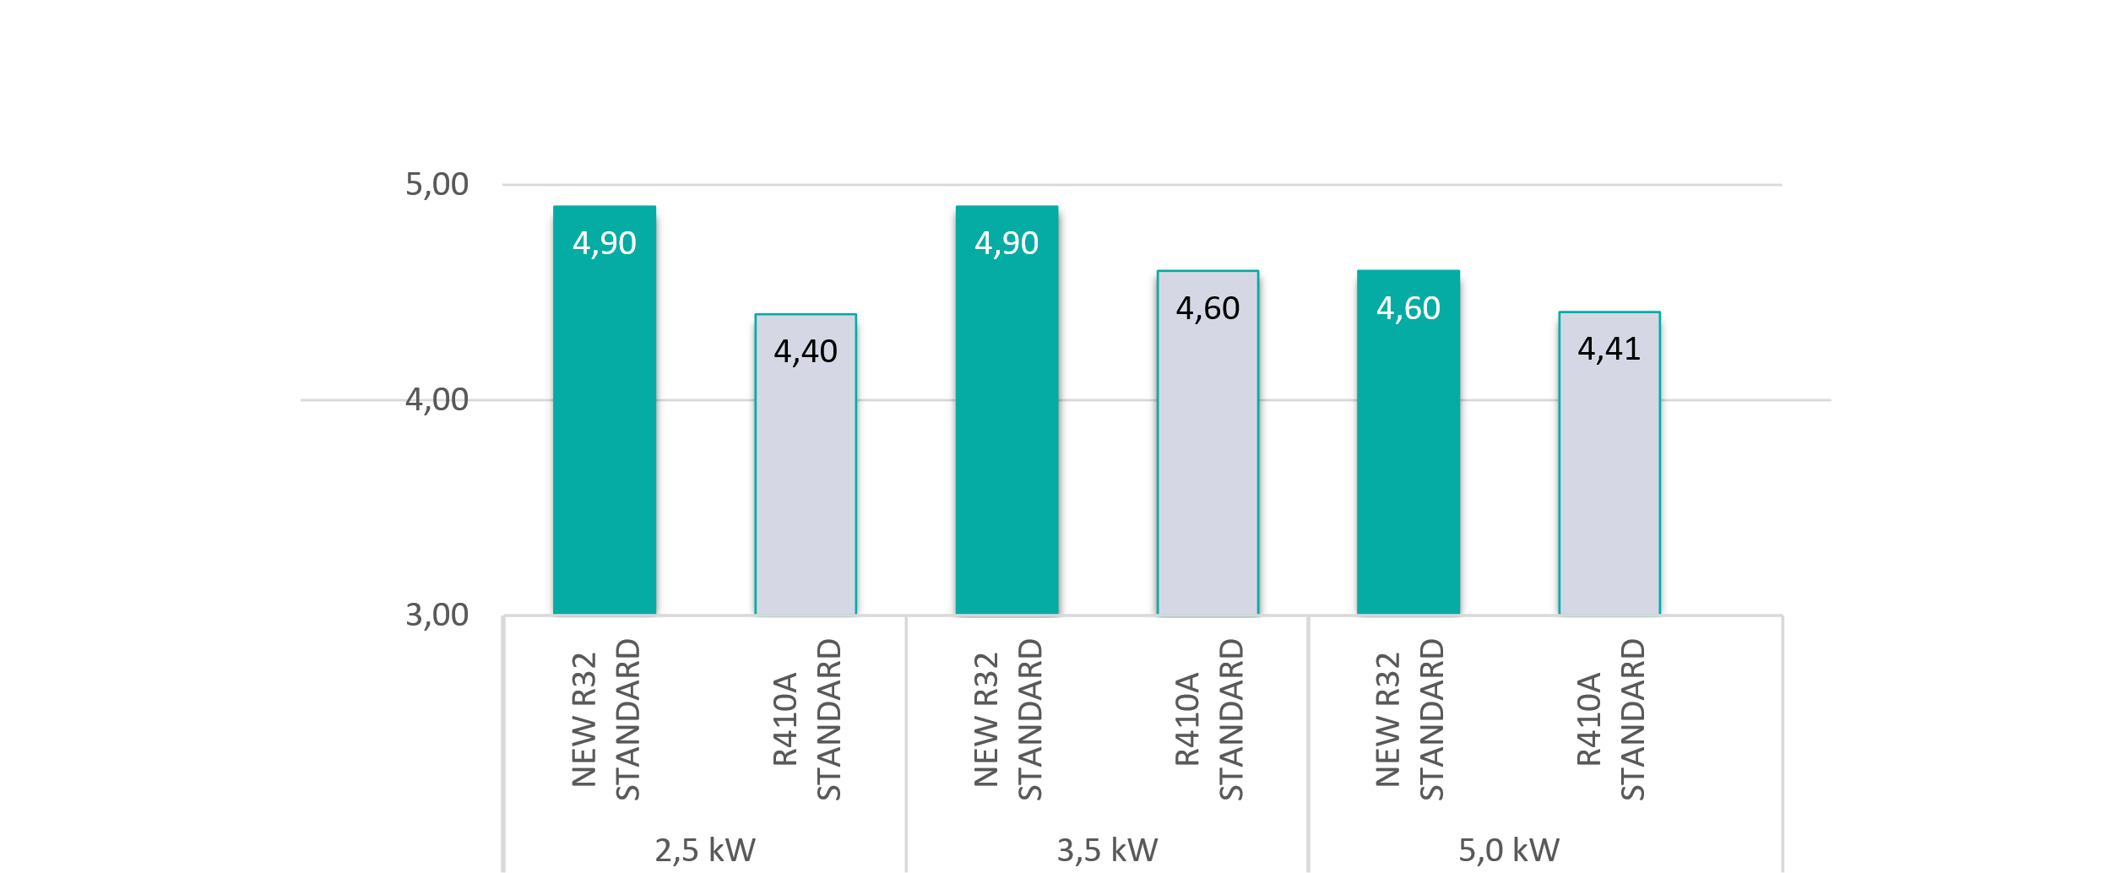
IMPROVEMENTS
R32 Standard vs R410A Standard: SCOP
A++
A++
A+
A++
A+
A++
SCOP have been improved for all the range.
➔ 1 energy class more for 2.0 and 2.5 kW

Slide 42

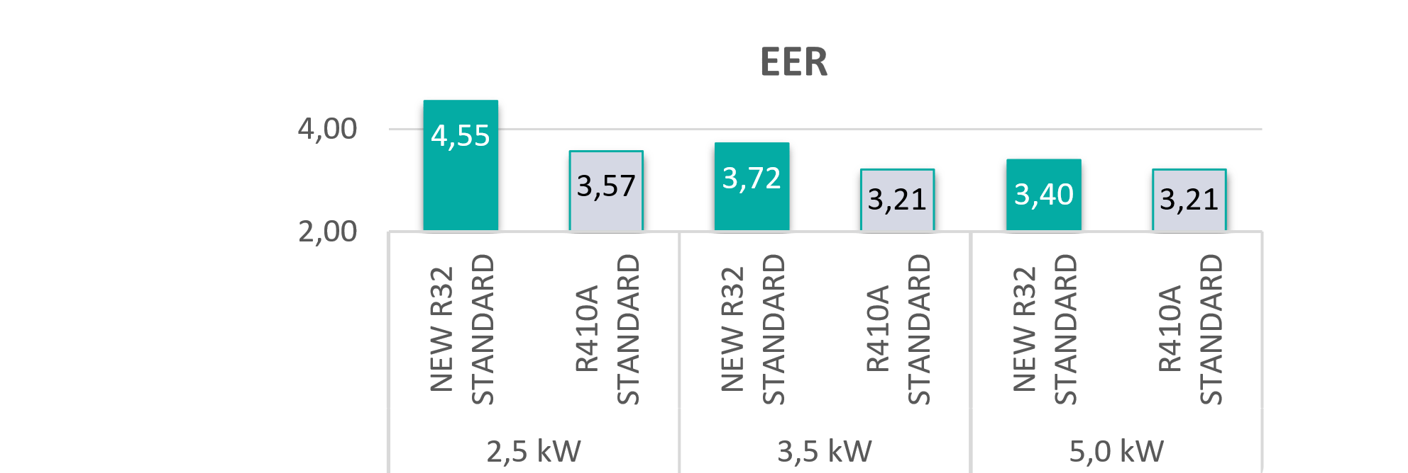
IMPROVEMENTS
R32 Standard vs R410A Standard: COP/EER
A++
A+
A++
A+
A++
3.705
Italy tax incentive
A+
A++
A+
A++
A+
A++
3.23
Italy tax incentive
A+
COP and EER have been improved for all the range

Slide 43
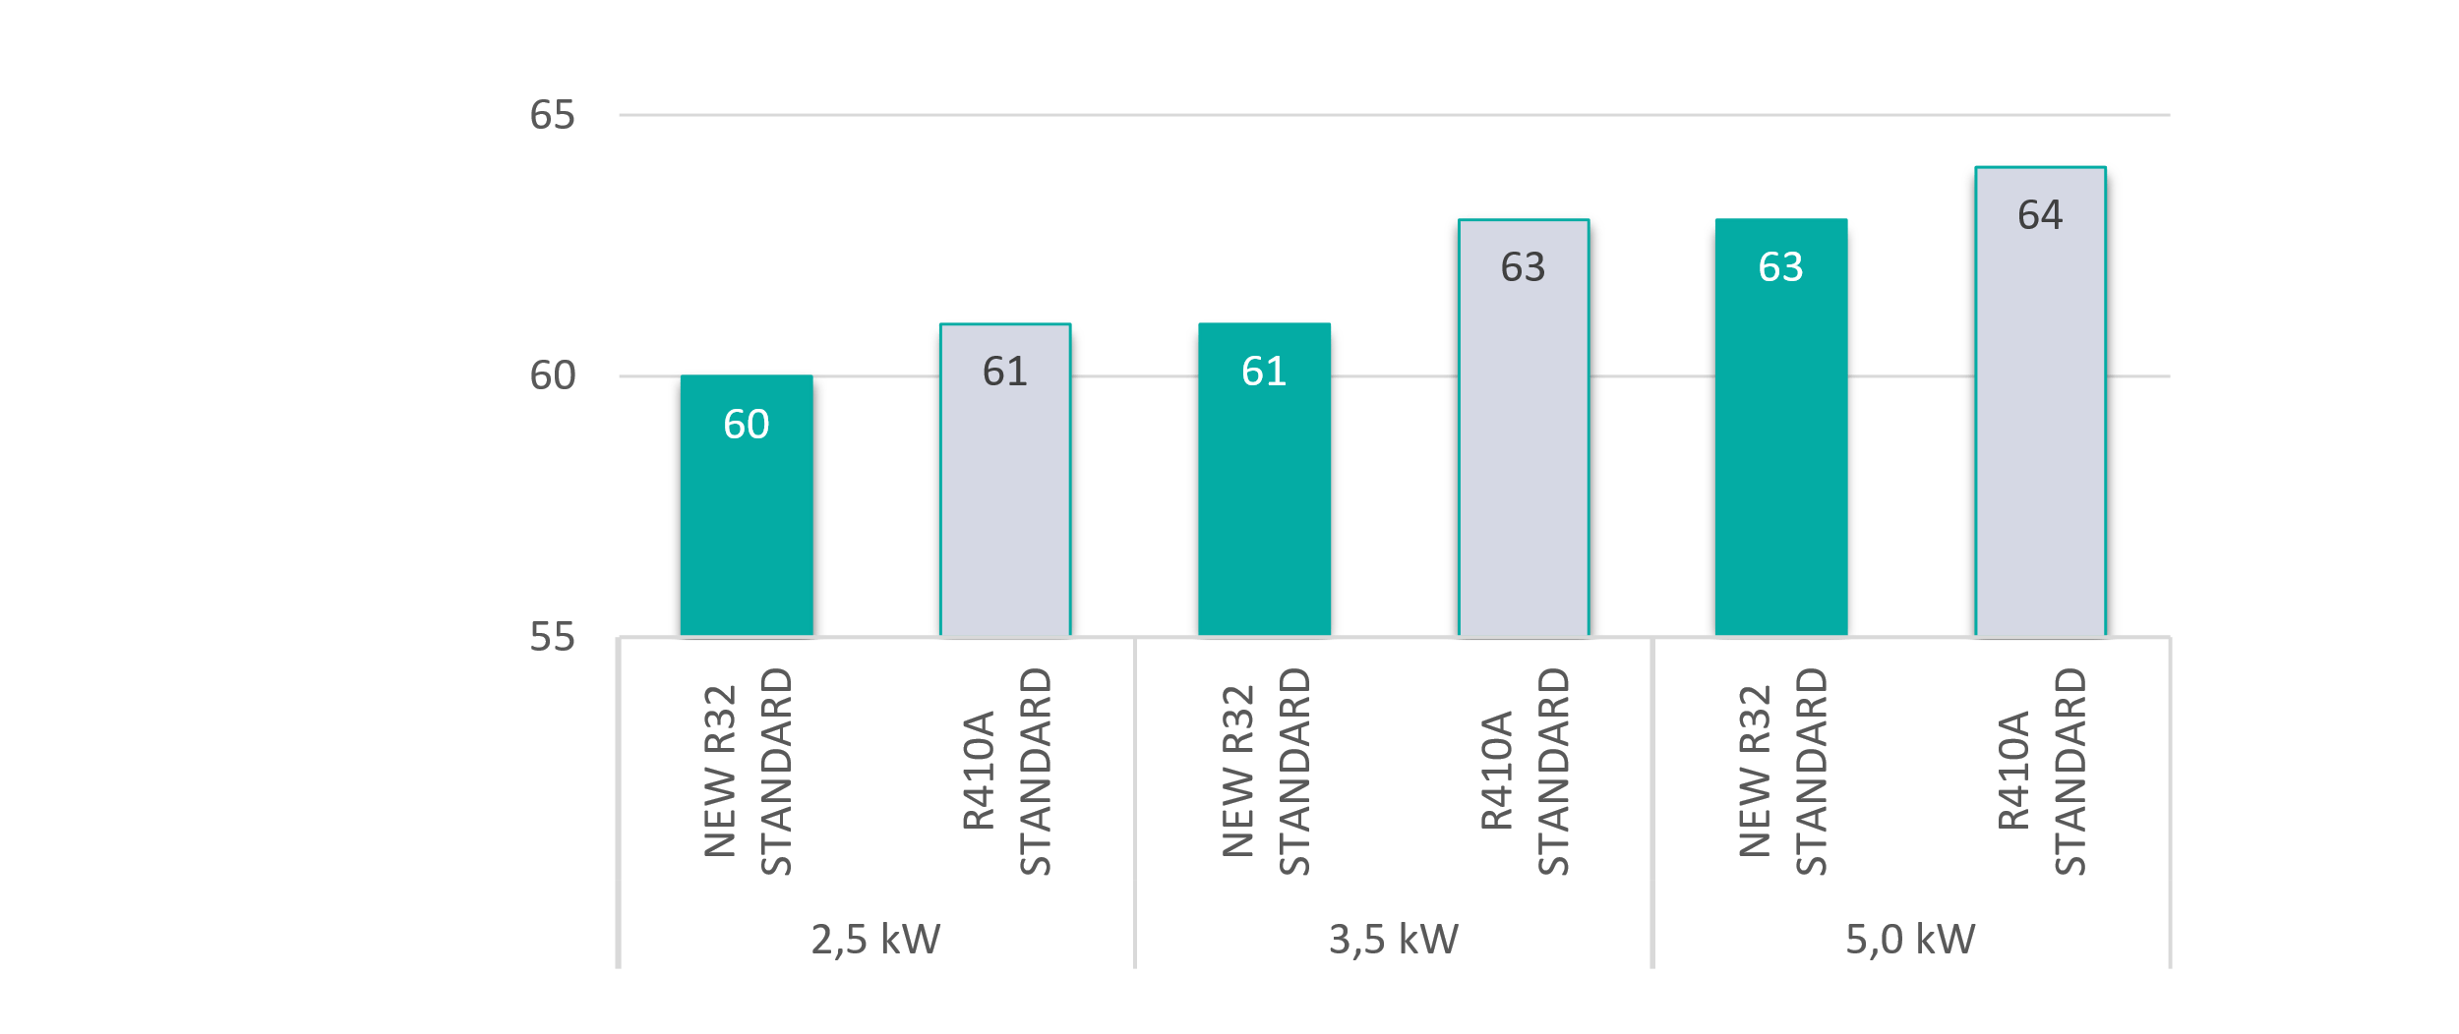
IMPROVEMENTS
R32 Standard vs R410A Standard: ODU sound power
A+
A+
A++
A+
A++
A++
ODU sound power have been drastically reduced for all the range
➔ Better integration in residential application

Slide 44
IMPROVEMENTS
Outdoor units dimensions
Current range (RAC-WPD)
2.5~3.5 kW | ~5.0kW
W 750
W 792
H 600
H 548
D 288
D 299
New R32 range (RAC-WPE)
2.5~3.5 kW | ~5.0kW
W 750
W 792
H 600
H 548
D 288
D 299
Same outdoor units dimensions

Slide 45
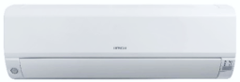
IMPROVEMENTS
Indoor units dimensions
Current range (RAK-(Q/R)PD)
2.5 – 3.5 – 5.0kW
W 780
H 280
D 230
New R32 range (RAK-(Q/R)PE)
2.5 – 3.5 – 5.0kW
W 780
H 280
D 230
Compact indoor unit ➔ 780 mm width for all the range
- Easy installation above a door

Slide 46
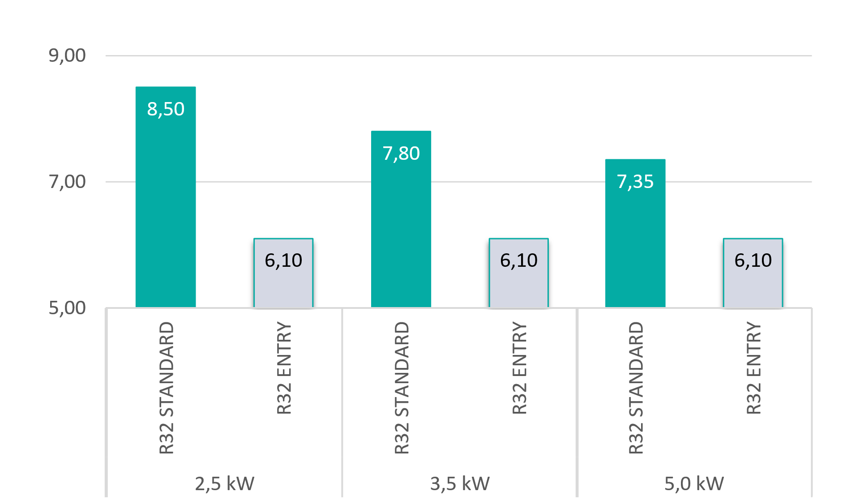
IMPROVEMENTS
R32 Standard vs R32 Entry: SEER
A++
A++
A++
A+
A+
A+
Standard SEER have been improved in order to keep range consistency:
1 energy class more for 2.0 and 2.5 kW units
- 20% difference for 3.5 and 5.0 kW units

Slide 47
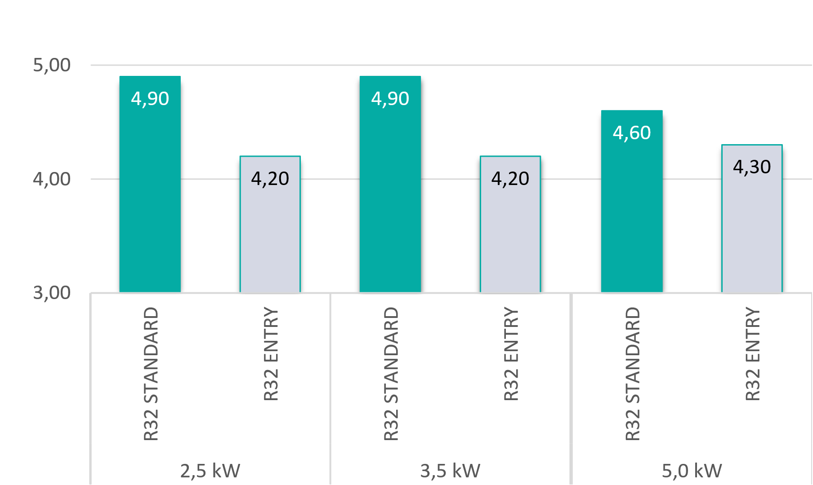
IMPROVEMENTS
R32 Standard vs R32 Entry: SCOP
A++
A++
A++
A+
A+
A+
SCOP have been improved in order to keep range consistency:
1 energy class difference for all the range

Slide 48
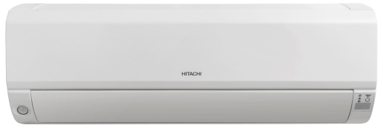
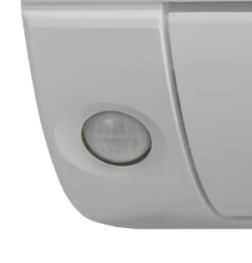

IMPROVEMENTS
Compact dimension: 780mm (width)
Shiny Finish
STAR WHITE
Invisible
Human sensor
Discreet
design
Shape and texture as an interior living element

Slide 49
CONTROLS RANGE
NEW
RAR-6NE1
Weekly wireless remocon
SPX-WKT3
Weekly wired remocon
Main features:
Weekly timer
Energy consumption / Room temp. /
Alarm codes
Frost Wash function
Main features:
Weekly timer
Energy consumption / Room temp.
/ Alarm codes
Centralized control possible
Lock
Eco-Auto Off
SPX-WFG01
Wi-Fi
SPX-RCDB
Simple wired remocon
Main features:
Weekly timer
Room temp. / Alarm codes
Centralized control possible
Main features:
Simple timer
Centralized control possible
Complete range in order to match with all the applications

Slide 50
SUMMARY
NEW
Exclusive features: Frost Wash
High seasonal performances: A+++ / A++
High heating capacity @-7°
Compact dimensions (width = 780 mm)
Sustainable refrigerant R32
Easy maintenance: chassis and HiKumo Pro compatibility
Easy installation: New one piece made chassis
Human sensor
Complete controls range (including Wi-Fi control)
IU design – Unified for all the range
4 Way Swing
Compact
EASY
MAINTENANCE
SCOP
SEER
4 Way Swing
Very competitive unit to match perfectly with market requirements

Slide 51
New R32
Wall Entry
RAK-REF/RAC-WEF

Slide 52
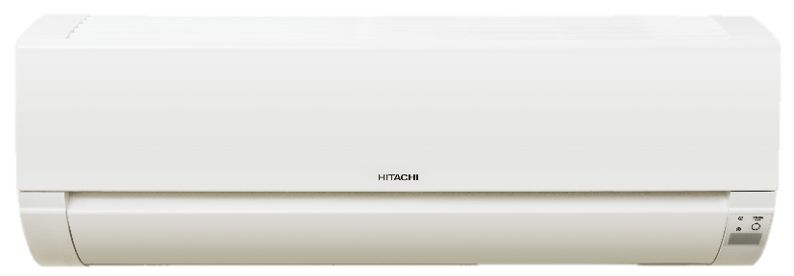
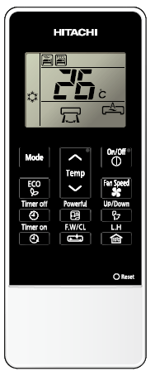


New Wall Entry
RAK-REF / RAC-WEF
Launching Date: FY20 Q3
Features
Energy savings
High seasonal performances SEER A++ / SCOP A+
Air quality
Exclusive Frost Wash feature to match end-user requirements
Compact & discreet design:
Width 780mm perfect to install above the door
New user friendly remocon including Frost wash function
Easy selection: Single & Multi compatibility for IDU
Connectivity: Compatible with HiKumo & HiKumoPro
NEW
Capacity kW | 2.5 | 3.5 | 5.0
 | ● | ● | ●
EASY MAINTENANCE
COMPACT
FROSTWASH
R32
SEER
SCOP
COOLING
HEATING
HIGH
EFFICIENCY
A new compact Wall Entry range with a high level of differentiation on a trendy market thanks
to the new Frost Wash function

Slide 53

Line-up
 | 2,5kW | 3,5kW | 5,0 kW
IU design
IU reference | RAK-25REF | RAK-35REF | RAK-50REF
OU reference | RAC-25WEF | RAC-35WEF | RAC-50WEF
IR Remocon reference | RAR-7PE1 | RAR-7PE1 | RAR-7PE1
Controls | Hi-Kumo & Fulldot (SPX-WKT3) | Hi-Kumo & Fulldot (SPX-WKT3) | Hi-Kumo & Fulldot (SPX-WKT3)

Slide 54
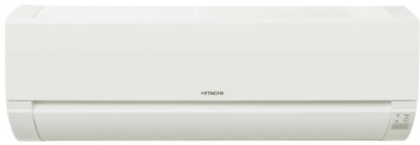
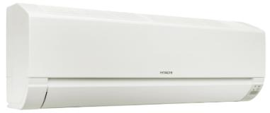
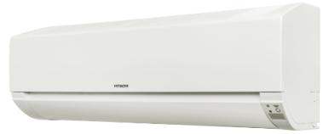

Indoor Unit Design
780 mm only
One of the thinner unit on the market
New light for
FrostWash function
on the IDU
Front cover is “one piece made”
No color difference between chassis and front cover

Slide 55
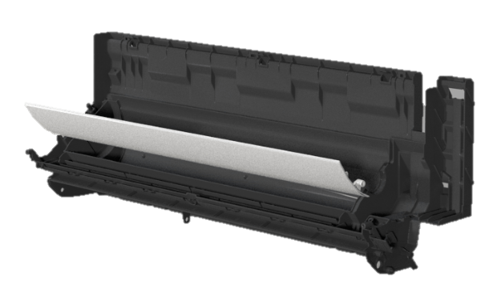
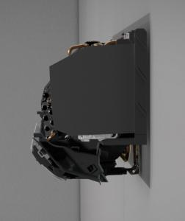
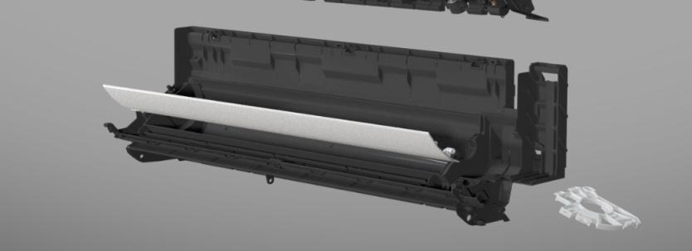
End user benefits
  Combine cabinet and drain pan in one piece made
Air circulation improvement → better performances

Slide 56
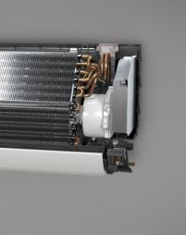
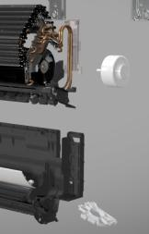
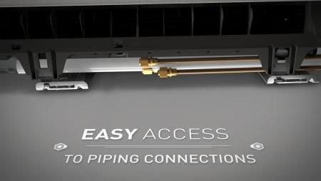
Installer benefits
Fan motor can be easily sliced and removed
without removing the heat exchanger
    Easy access to the piping beneath the unit
Installation time saving for the installer

Slide 57


NEW GENERATION OF CONTROLLERS ENTRY UNITS

Slide 58
New Entry Remocon
RAR-7PE1
A new design wall entry remocon with the new Frostwash function.
New Black and White design
➔ Improve Hitachi brand image with an increasing quality of
the Entry remocon
Same function as the current remocon + New Frost Wash function
Temp. setting
Mode selector
ON / OFF
Eco mode
Fan speed setting
Timer ON & OFF
Swing
New FrostWash button
Leave home
Harmonization of the RAC wireless remocon → Brand modernization thanks to trendy design remocon

Slide 59
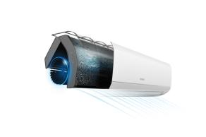
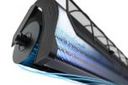
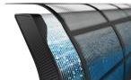




FrostWash
How does it work?
Freeze the heat exchanger at -15°C, creating plenty of water to wash away accumulated dust on the Heat Exchanger.
Operating procedure
FREEZE
MELT & WASH
DRY
20 min
1 min
60 min
Freeze the Heat Exchanger
Melt the Frost at once
to Wash away the dust
Dry the Heat Exchanger
FrostWash → The easiest and most efficient way to have a clean IDU

Slide 60

New Single Wall Entry
Energy efficiency
Air Quality
Aesthetics
SEER = A++
SCOP = A+
SCOP = A+++ in Warmer Climates
Frost wash function available from this year
Keep the heat exchanger clean by freezing and melting, thus improving Air Quality
New black and white design remocon for Wall Entry only
Improve brand image and product quality through simple details
Enhanced features with cost reduction: more value for your customers and more margin for your sales

Slide 61
Controls Range
Weekly wireless remocon
SPX-WKT3
Weekly wired remocon
Main features:
Weekly timer
Energy consumption / Room temp. /
Alarm codes
Main features:
Weekly timer
Energy consumption / Room temp.
/ Alarm codes
Centralized control possible
Lock
Eco-Auto Off
SPX-WFG01
Wi-Fi
SPX-RCDA/B
Simple wired remocon
Main features:
Weekly timer
Room temp. / Alarm codes
Centralized control possible
Main features:
Simple timer
Centralized control possible
Complete range in order to match with all the applications

Slide 62
–
New R32
Multi
RAC Product Development

Slide 63





Multi Outdoor Units Range
(RAM-NP-E)
Factory: JCH-MY for RAM33 to RAM90 / JCH-WH for RAM110
Availability date: FY19Q3
Line-up
2 Rooms | 3 Rooms |  | 4 Rooms | 5 Rooms
5.30 kW | 5.30 kW | 6.8 kW | 7.0 kW | 8.5 kW | 10.6kW
RAM-53NP2E | RAM-53NP3E | RAM-68NP3E | RAM-70NP4E | RAM-90NP5E | RAM-110NP5E
Features
Energy savings:
High seasonal performances: SEER A+++ / SCOP A++
Hibernate
High comfort level
High heating capacity at low temperatures
Low sound level ➔ Vector Control
Wide and complete range:
Exclusive 3.3kW unit
New high capacity unit (single fan): 10.6kW - 5 rooms
R32
HIBERNATE
SEER
SCOP
COOLING
HEATING
HIGH
EFFICIENCY

Slide 64








Multi Indoor Unit Range
Features
Flexibility
24 Indoor units connectable
Consistent line-up
from 2.0 to 6.0kW units available for every model
Efficient & comfortable
Residential & Light Commercial applications
Indoor Units
Wall |  |  | Duct | Floor | Cassette
RAK-Q/RXE From 2.0 to 5.0kW | RAK-Q/RPE From 1.5 to 5.0kW | RAK-RPE(1) 5.0 /6.0kW | RAD-Q/RPE From 2.0 to 6.0kW | RAF-RXE From 2.5 to 5.0kW | RAI-RPE From 2.5 to 6.0
Complete range matching with all applications

Slide 65



FY19 Line-up
Model switch
Type | Room | Capacity | Current |  | New
 |  |  | Reference | Design | Reference | Design
 |  | 5.3 kW | RAM 53NP2B |  | RAM-53NP2E
 | 3 | 5.3 kW | RAM 53NP3B |  | RAM-53NP3E
 |  | 6.8 kW | RAM 68NP3B |  | RAM-68NP3E
 | 4 | 7.0 kW | RAM 70NP4B |  | RAM-70NP4E
 | 5 | 8.5 kW | RAM 90NP5B |  | RAM-90NP5E
 |  | 10.6kW |  |  | RAM-110NP5E
 | 6 | 10.6kW | RAM 110NP6B
NEW
Current models which will be replaced
Current models which will be kept
New models
Remove current RAM110 (2 fans – 6 rooms) and replace by RAM110 (1 fan - 5 rooms)

Slide 66
Hibernate
Smart regulation which reduces by 70% stand by consumptions
Shut down sub circuits of non-active components
Drop of stand by power
Improvement of seasonal performances
All LEDs on outdoor units are switched off
Exclusive improvement of seasonal performances

Slide 67




IDU Range
Wall
What’s new?
New 5,0 and 6,0 kW units ➔ Light Commercial models
4
Duct
What’s new?
New 5,0 and 6,0 kW units ➔ Light Commercial models
  Static pressure = 150 PA
Cassette
What’s new?
New 6,0 kW units
Alignment with Light Commercial IDU
  New design
  Human sensor (standard)
  Individual louver control
Floor
What’s new?
Gas leak sensor (optional)

Slide 68
Controls Range
Weekly wireless remocon
SPX-WKT3
Weekly wired remocon
Main features:
Weekly timer
Energy consumption / Room temp. /
Alarm codes
Main features:
Weekly timer
Energy consumption / Room temp.
/ Alarm codes
Centralized control possible
Lock
Eco-Auto Off
SPX-WFG01
Wi-Fi
SPX-RCDA/B
Simple wired remocon
Main features:
Weekly timer
Room temp. / Alarm codes
Centralized control possible
Main features:
Simple timer
Centralized control possible
Complete range in order to match with all the applications

Slide 69
SPX-RAMHLK
What is this new accessory?
New H-Link gateway for R32 Multi range.
This new Accessory will be installed in the Outdoor unit.
The terminal will be inside OU electrical box.
Why SPX-RAMHLK model name?
SPX–RAMHLK
SPX
Following current model name logic for gateway
HLK
for H-Link
RAM
for Multi Outdoor Unit
New SPX-RAMHLK, the new H-link gateway for R32 Multi range

Slide 70

SPX-RAMHLK
Concept
Before
After
PSC-6RAD x 4
SPX-RAMHLK x1
CS-Net
CS-Net
Benefit
Time saving for installer
Cost saving for installer / End-user
New SPX-RAMHLK, the new H-link gateway for R32 Multi range

Slide 71
CONTROLS RANGE
RAR-6NE1
Weekly wireless remocon
SPX-WKT3
Weekly wired remocon
Main features:
Weekly timer
Energy consumption / Room temp. /
Alarm codes
Main features:
Weekly timer
Energy consumption / Room temp.
/ Alarm codes
Centralized control possible
Eco-Auto off
Lock
SPX-WFG01
Wi-Fi
SPX-RCDB
Simple wired remocon
Main features:
Weekly timer
Room temp. / Alarm codes
Centralized control possible
Main features:
Simple timer
Centralized control possible
Complete range in order to match with all the applications

Slide 72
SUMMARY
Energy savings:
High seasonal performances: SEER A+++ / SCOP A++
Hibernate
High comfort level
High heating capacity at low temperatures
Low sound level ➔ Vector Control
Wide and complete range:
Exclusive 3.3kW unit
New high capacity unit (single fan): 10.6kW - 5 rooms
Flexibility
24 Indoor units connectable
New H-link gateway accessory: SPX-RAMHLK
Consistent line-up
from 2.0 to 6.0kW units available for every model
Efficient & comfortable
Residential & Light Commercial applications
Compatibility with HiKumo & the new HiKumo Pro solution
SCOP
SEER
Very competitive unit to win market share against competitors

Slide 73
Thank you

